Slide 1

Quick recap
Day 4

Slide 2
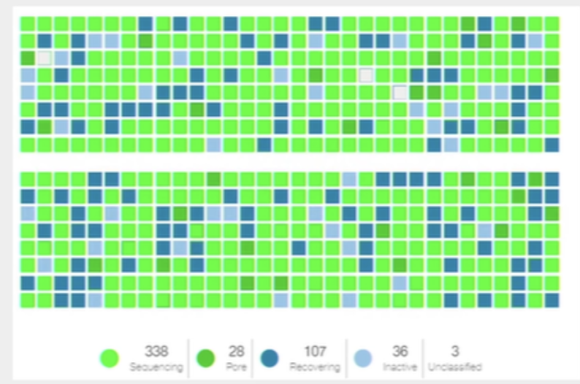
Nanopore sequencing
The group collectively prepared a library!
16 positive samples
4 negative controls
20 barcodes (NBD 1-20)
Flowcell check was good (1414 pores)
Compared to 1431 at warranty QC (performed 1/02/2024)
Run with live basecalling

Slide 3
Problems/changes during prep
QC check failed with an error because wifi not connected
Can make MinKNOW run offline
Or only need connection for start of a run
We didn’t pack enough Short Fragment Buffer (SFB)
We used a lower volume (125 instead of 250ul)
Some problems with small volumes
Barcode volumes were small and hard to pipette (another aliquot provided)

Slide 4
Run metrics
Library added to flowcell: 200fmol
Pore occupancy ~60%
Run time: 2h 37m
Reads: 1.67million
Estimated bases: 971.33Mb (megabases)

Slide 5
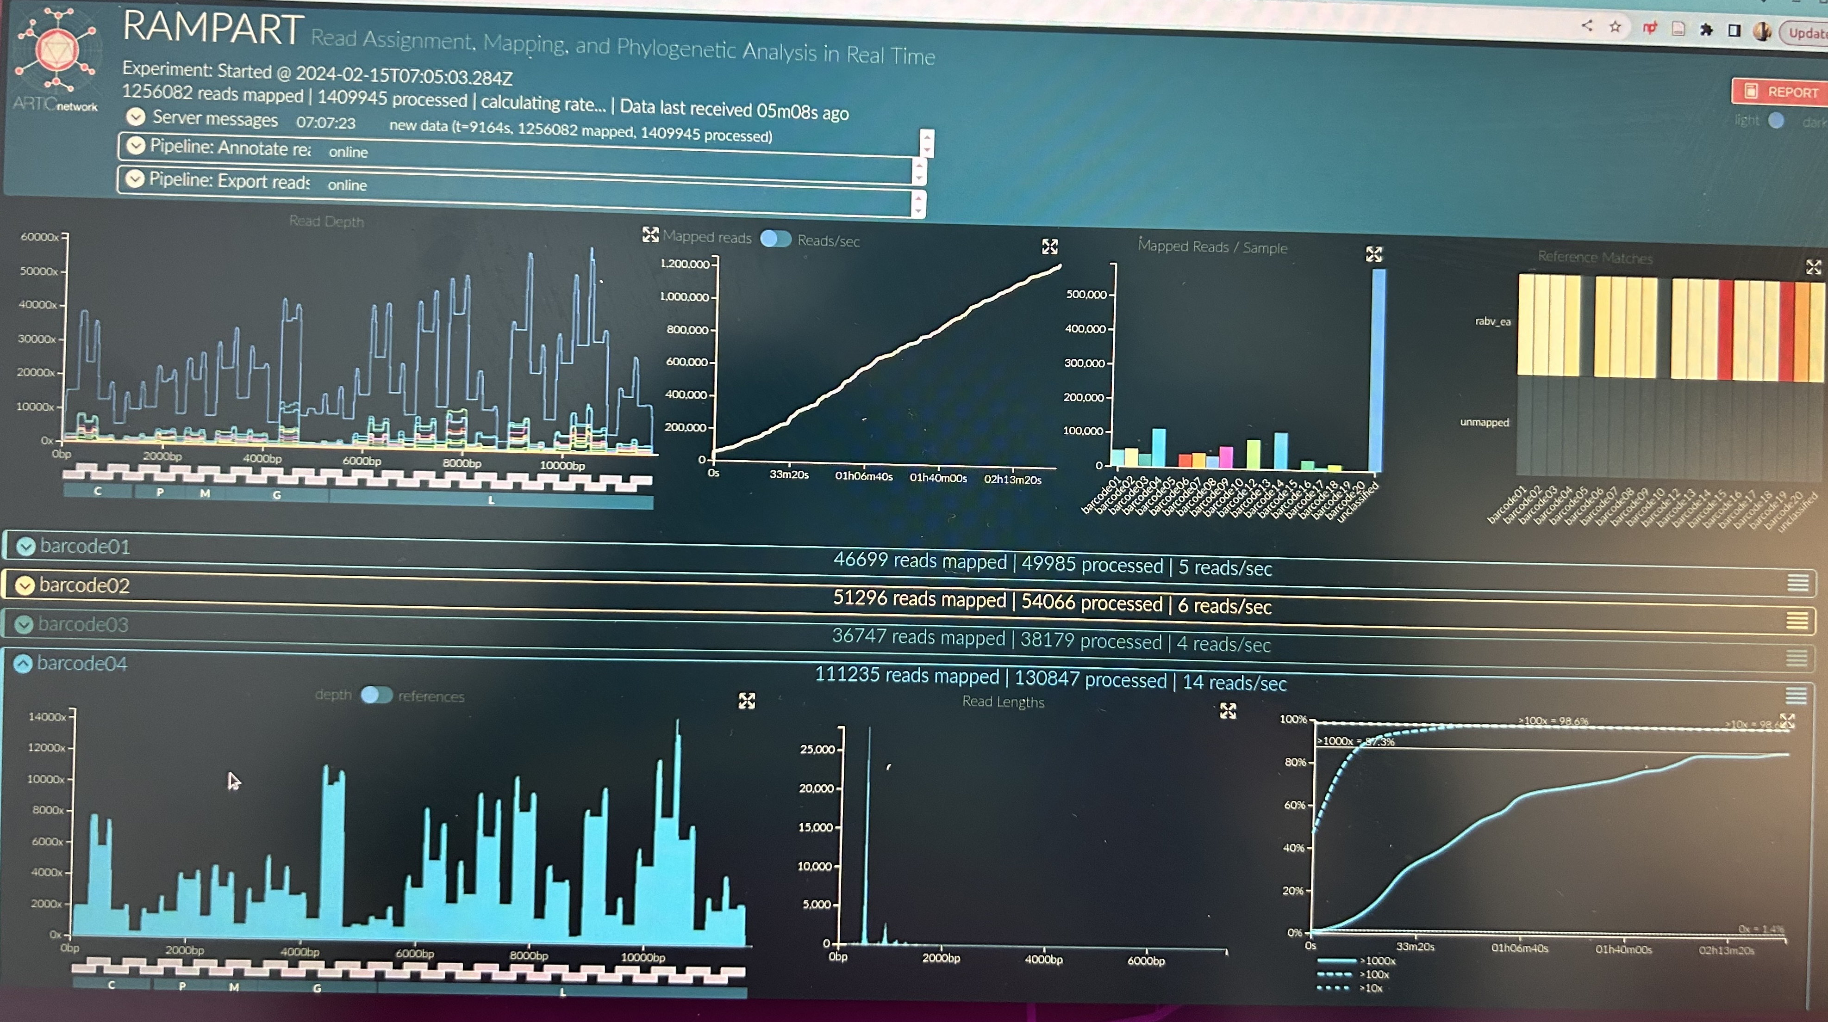
PLATEAU

Slide 6
What happened after the run?
Performed a flowcell wash
Contains DNase I, which is used to digest any remaining library on a flow cell
Should remove 99.9% of the library
Some residual DNA may remain & may be prefer to use different barcodes on consecutive run (e.g. barcodes 1-24 on 1st run, barcodes 25-50 on 2nd run)
Can only recover pores lost to the “recovering”/”unavailable” state
Our run: >1000 pores were left active, ~300 in unavailable state
But I only had 628 pores after washing
Found some interesting things on the forum about this…

Slide 7
Calculating Molarity
To calculate the molarity of a solution, the number of moles of solute must be divided by the total liters of solution produced.
If the amount of solute is given in grams, we must first calculate the number of moles of solute using the solute’s molar mass, then calculate the molarity using the number of moles and total volume.

Slide 8
DNA/RNA molarity formula
M = w / MW
Where: M: DNA molarity, in mol w: DNA weight, in g MW: DNA molecular weight, in g/mol If only DNA length is given, the molecular weight is calculated as:
MW = DNA Length (bp) × DNA/RNA base weight The approx. double strand DNA base weight is 660 Dalton, for single strand is 330, for RNA is 340.
Or use this website:
https://nebiocalculator.neb.com

Slide 9
Our calculations
Groups 1 + 2 = 1.16ng/ul
Groups 3 + 4 = 0.709ng/ul
We used 15ul of each to use 30ul total volume of DNA in adaptor ligation reaction
So…
1.16 x 15= 17.4ng
0.709 x 15= 10.635ng
=28ng
Concentration

Slide 10
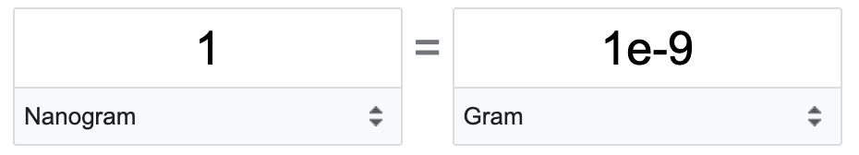
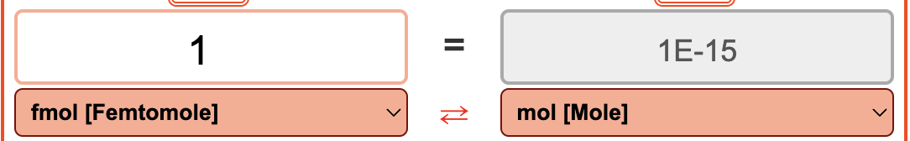
Our molarity
Concentration = 28ng
M = w / MW
MW = DNA Length (bp) × DNA/RNA base weight
MW = 400 x 660 = 264000
M = w / MW
M = (28x1e-9)/ 264000 = 1.06060606061×1e−13 moles
~106 fmol (femtomoles)

Slide 11
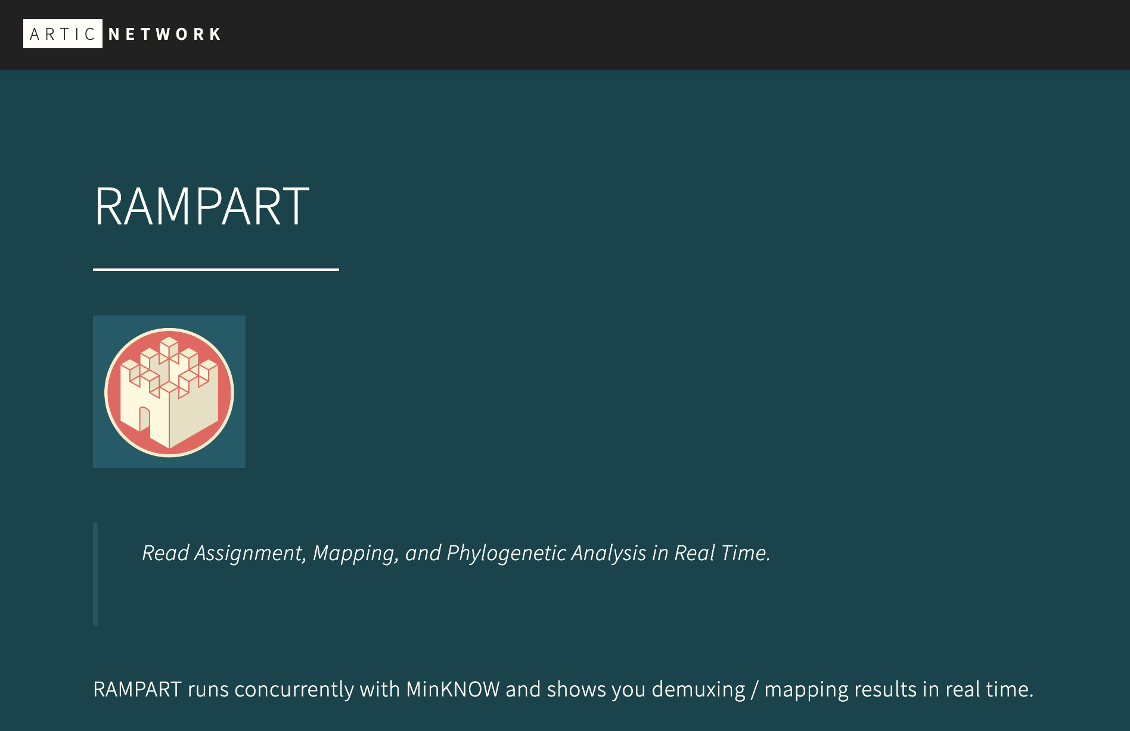
https://artic.network/rampart

Slide 12
Estimating required coverage
C = LN / G
C stands for coverage
G is the haploid genome length
L is the read length
N is the number of reads
So if I want to get 100X coverage of rabies genome
100= 400xN / 12000
N=3000 reads
However….

Slide 13
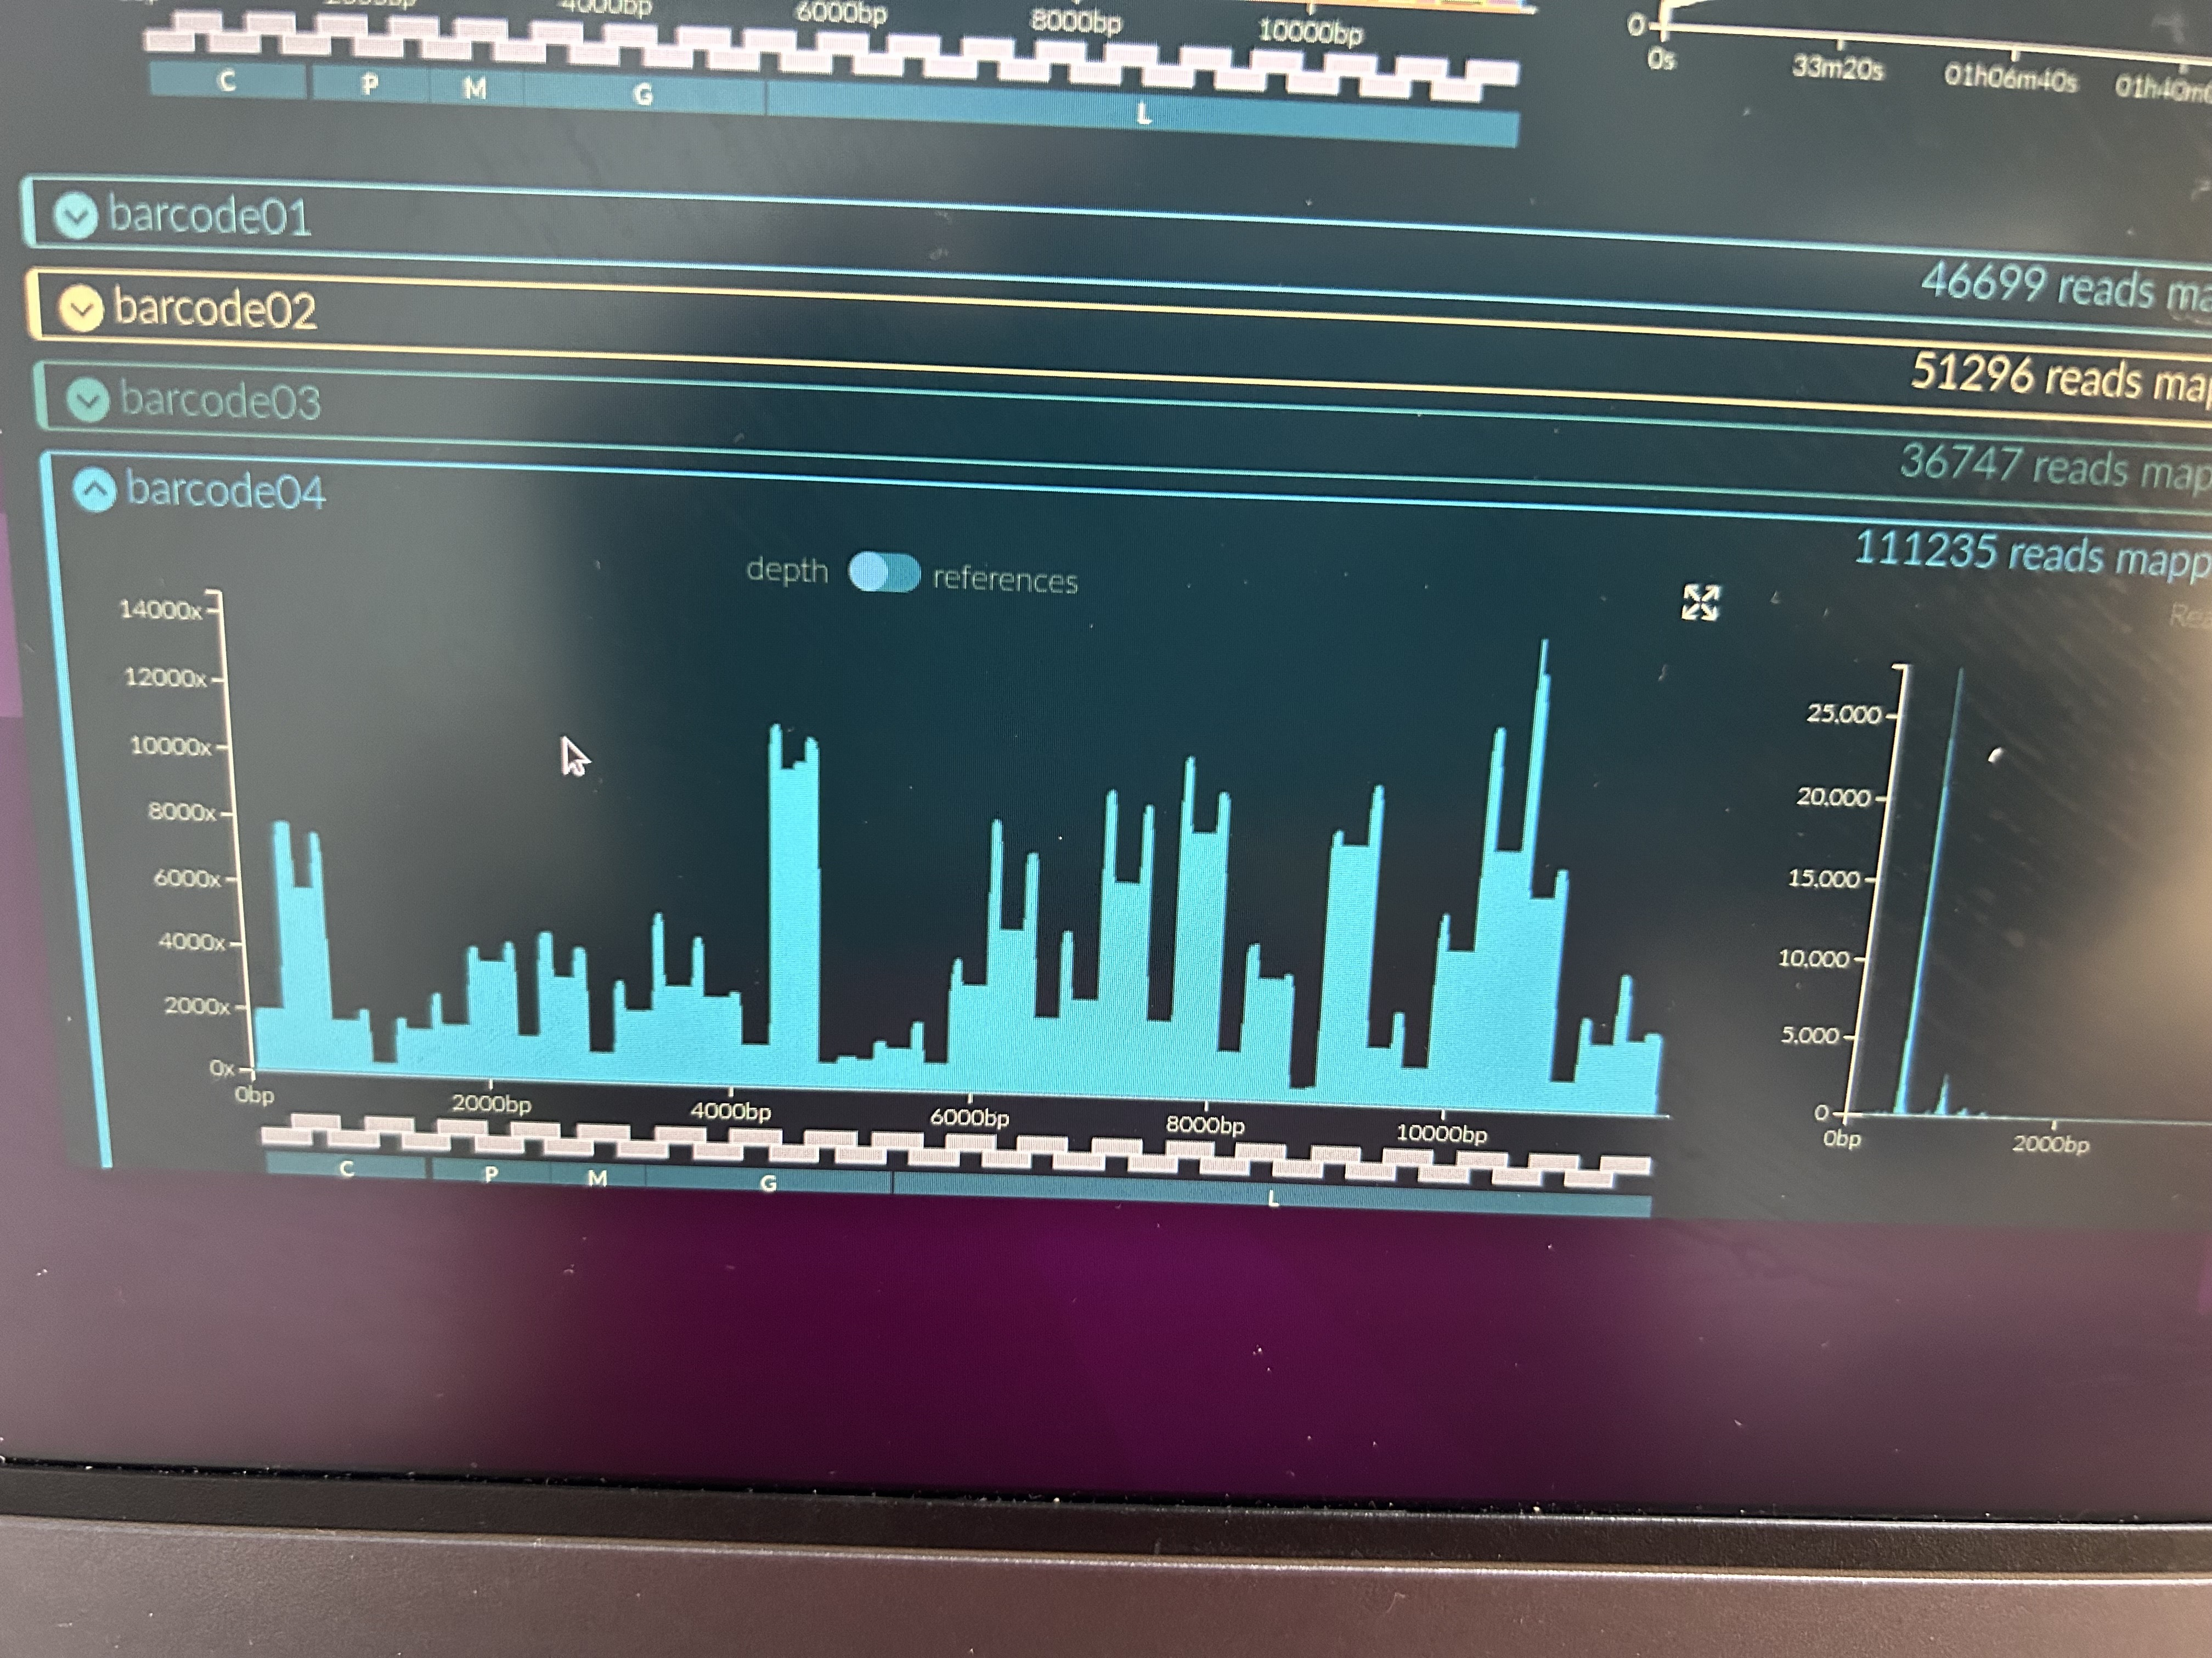
Variation between and within samples

Slide 14
What is the total output from a MinION flowcell?
50 GB is a theoretical maximum yield
Highly unlikely to reach
Forums suggest about 5-15 GB per run
Notes:
That 50 GB is basically a theoretical maximum yield (it's a bit fuzzy because a flow cell that's fully-loaded with well-prepared, clean DNA might keep sequencing for longer than 72 hours).
It's better to plan experiments based on minimum or average yield (e.g. an estimate is about 5-15 GB per run for R9.4.1 MinION flow cells).

Slide 15
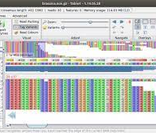

Lab-on-an-ssd (RAGE-on-an-ssd)
Think of it as a computer on a usb harddrive
Plug and play
An Ubuntu operating system (Linux)
Pre-installed software for sequencing and associated bioinformatics

